Slide 1
Week 9-10 challenges
ADS&AI

Slide 2
Reminder goal week 9-10 challenges
Blocks lasts for 8 weeks
In week 9 and 10 lecturers grade your work and prepare for next block
We want you to spend this time on developing yourself further
Good for your portfolio and finding a future job!

Slide 3
Grading
Content is not graded, but your participation is!
In Block C one of the professional ILO’s focuses on Extracurricular Activities
In the learning log block C provide evidence for your participation in week9-10 challenges for Block A, Block B, and Block C

Slide 4
Communication
General Brightspace ADS&AI is used for all communication
There will be discussion forums opened for each challenge to ask and answer questions
There is an assignment to share evidence with the contact person at the end of week 10

Slide 5
Block B Challenges
Duckietown
NAO & Pepper
Kaggle
Generative AI
AI at BUas – risks & opportunities
Soft skills: Mirro modules
Company challenge: DKG
Own challenge

Slide 6
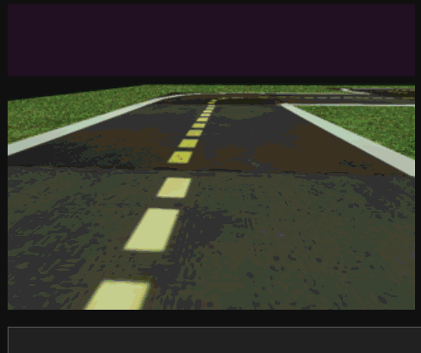
Duckietown – part II
In the block B challenge, there are two options.
For first timers, you will go through the basic challenges in the simulator
If you participated in block A, you will be able to more advanced challenges where you will implement computer vision and reinforcement learning in the simulator
For those that are successful in the advanced challenges, you will have the chance to try out your algorithms on a real Duckiebot
The challenge is in teams of 4 students.
Contact person: Dean van Aswegen

Slide 7
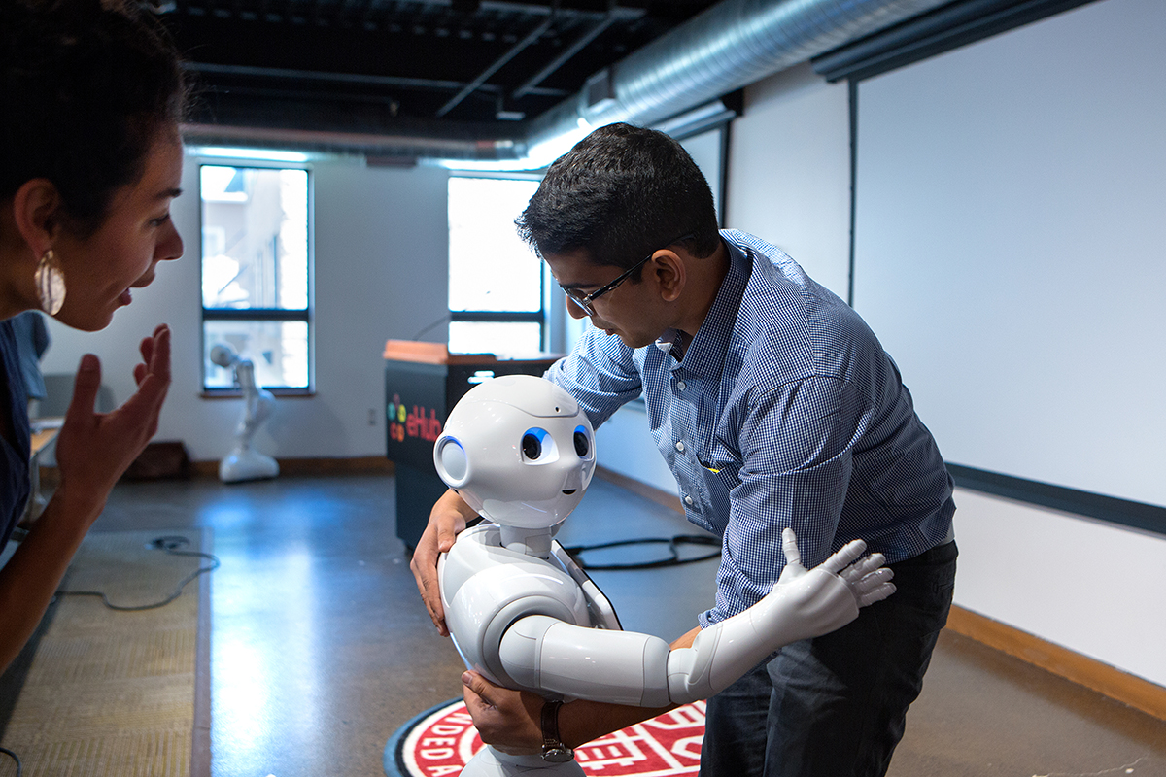
NAO and Pepper – Part II
Robots were used in the open day successfully
In a team of 4 students, you will get access to either a NAO or a Pepper robot for week 9 and 10
Create an application focusing on social interaction between humans and robots
Contact person: Margot Neggers

Slide 8

Kaggle
Kaggle is a platform where data scientists can compete in various challenges
In this challenge you will participate individually or in duo’s
Participate in either a playground challenge or the featured challenge: https://www.kaggle.com/competitions?hostSegmentIdFilter=8
Contact person: Alican Noyan

Slide 9
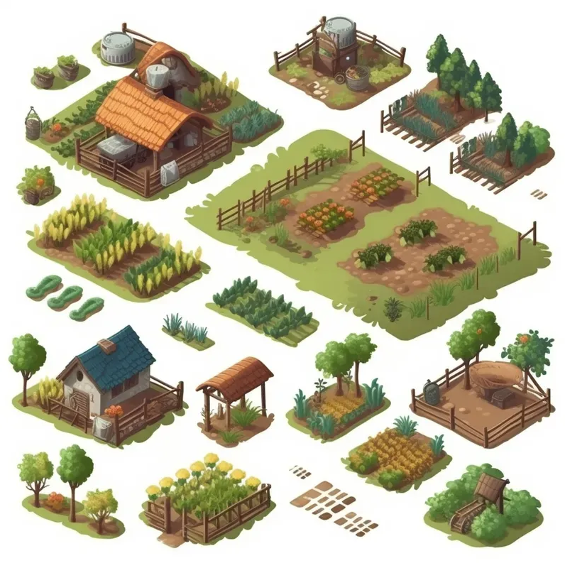
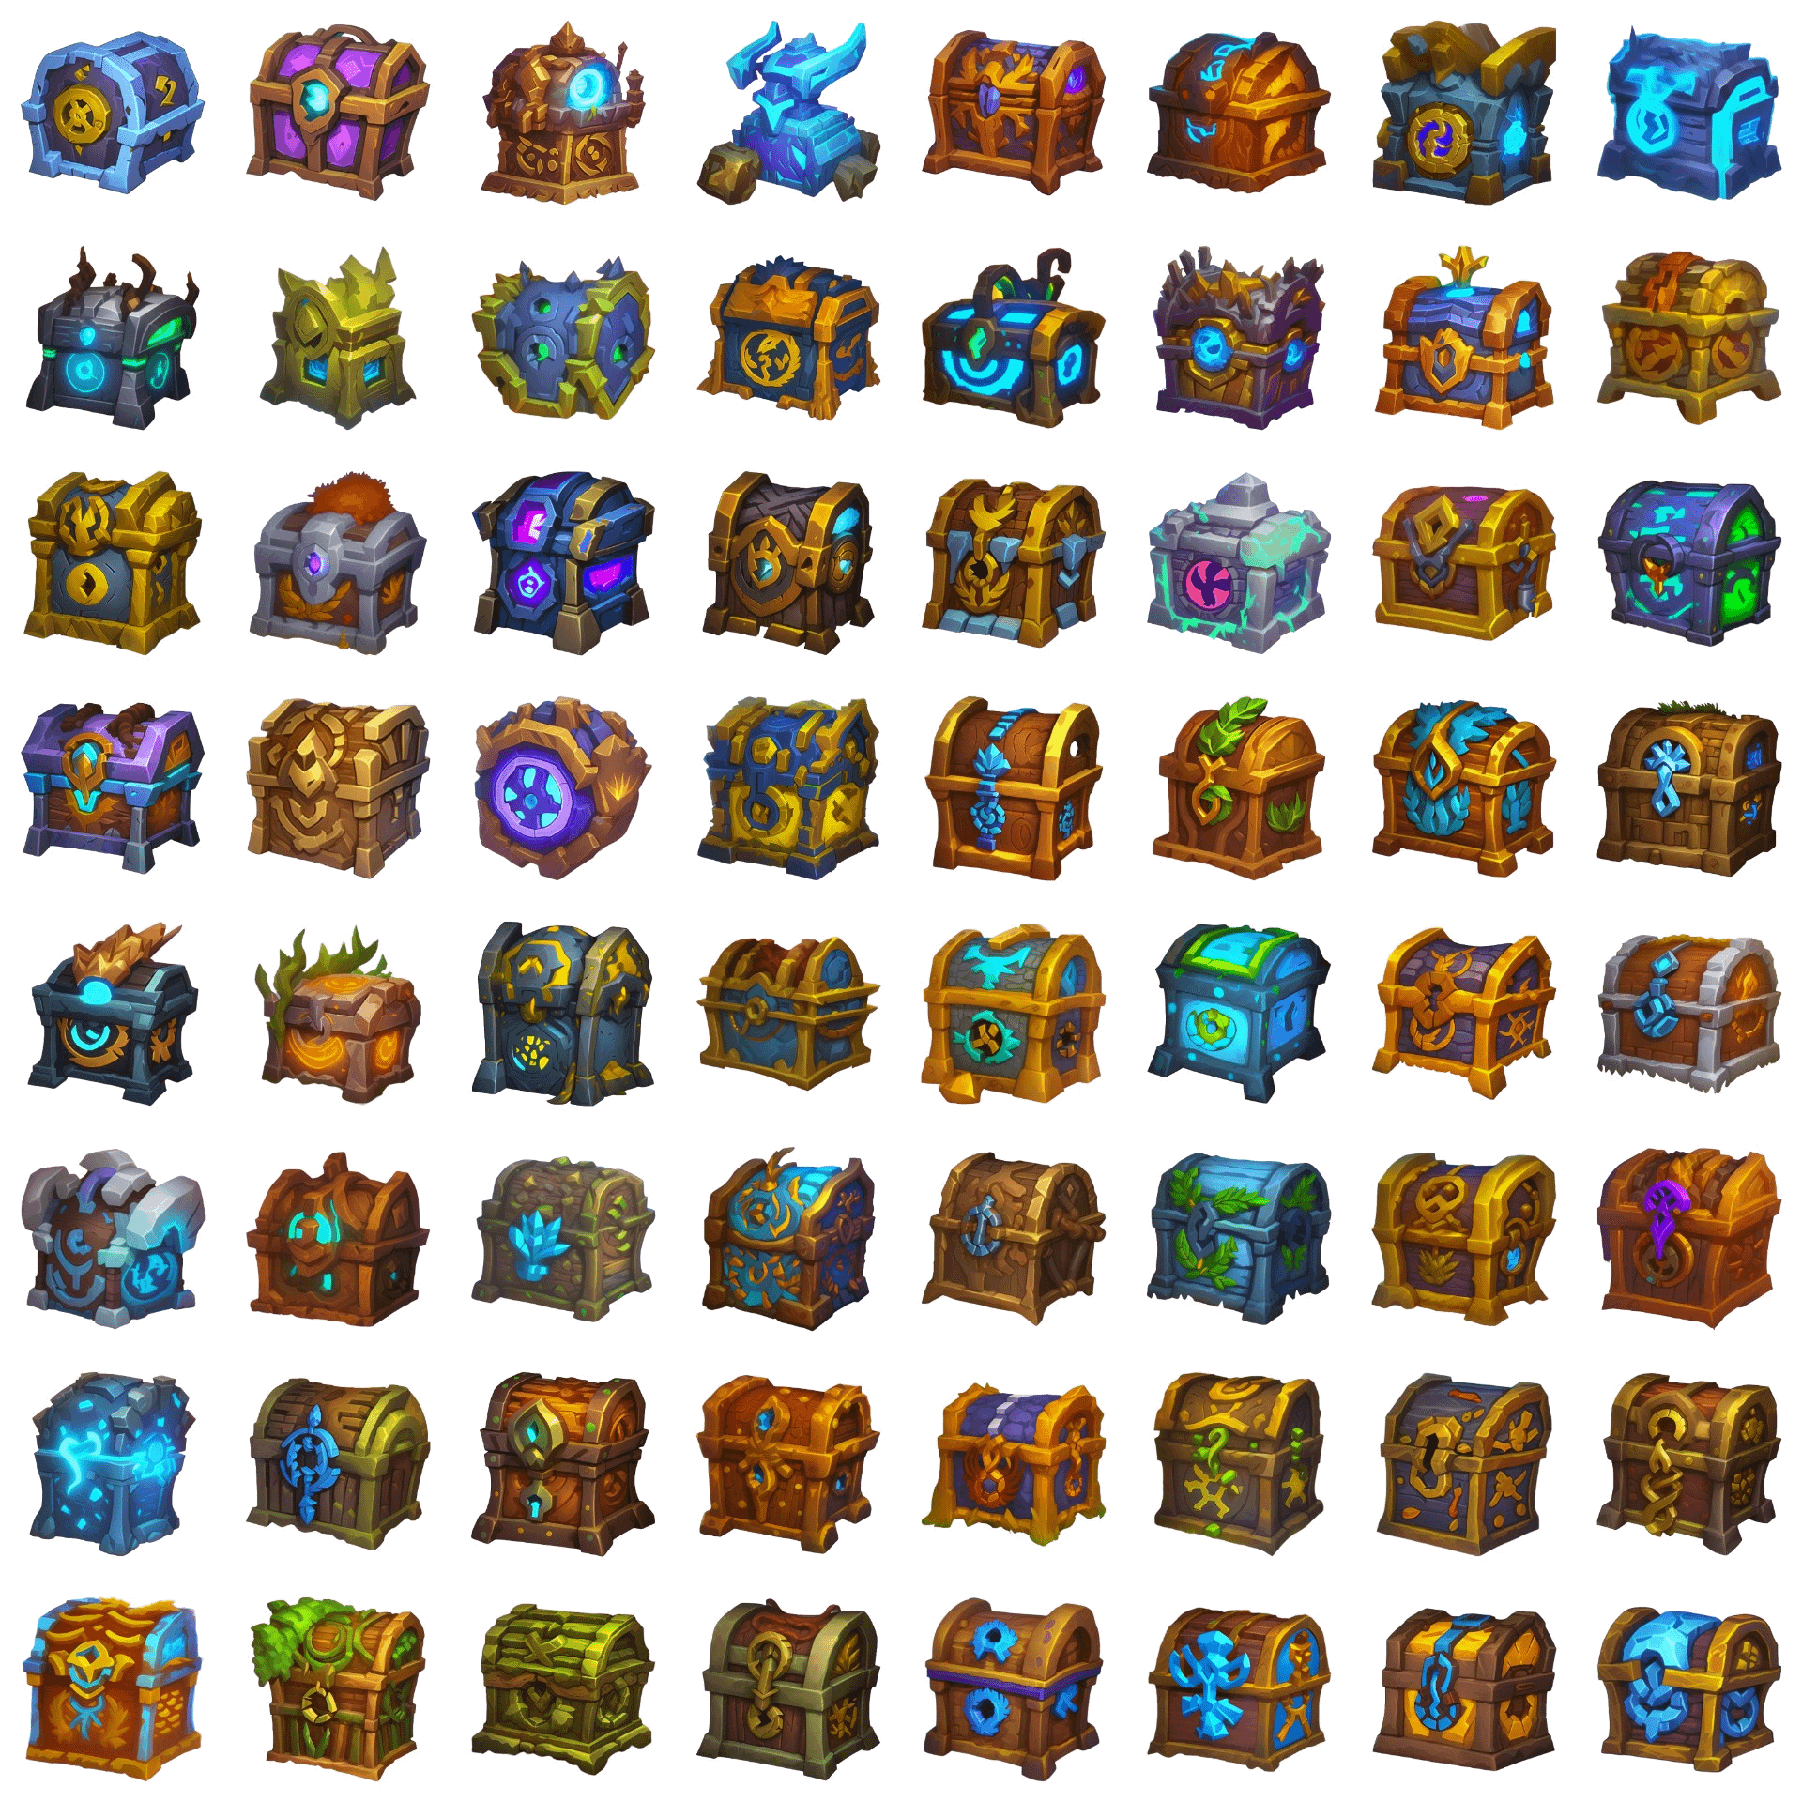
Generative AI: 2D Game Asset Generation
Stable Diffusion is a deep learning model capable of generating detailed images based on text descriptions. Although it is capable of generating good results, the base model is not optimized for certain types of images, such as game assets. However, it is possible to overcome these limitations by fine-tuning the model.
Challenge: fine-tune a Stable Diffusion model to generate game assets, such as items, characters, and objects.
Teams: duo’s or maximum 4 students per team
Contact Person: Edirlei Soares de Lima

Slide 10
AI at BUas – Risk & Opportunities
Submit your paper to a conference
Conferences:
https://www.aiet.org/
Submission deadline: 10th of February - https://www.aiet.org/sub.html
https://ytic.eu/
Submission deadline: March 24 - https://ytic.eu/callforpapers/
Requirements:
Improve or refine your research for Y2A
Your paper is selected for initial review → No desk reject
Follow the creative brief of Y2A for more information on the project: https://adsai.buas.nl/Year2/BlockA/

Slide 11
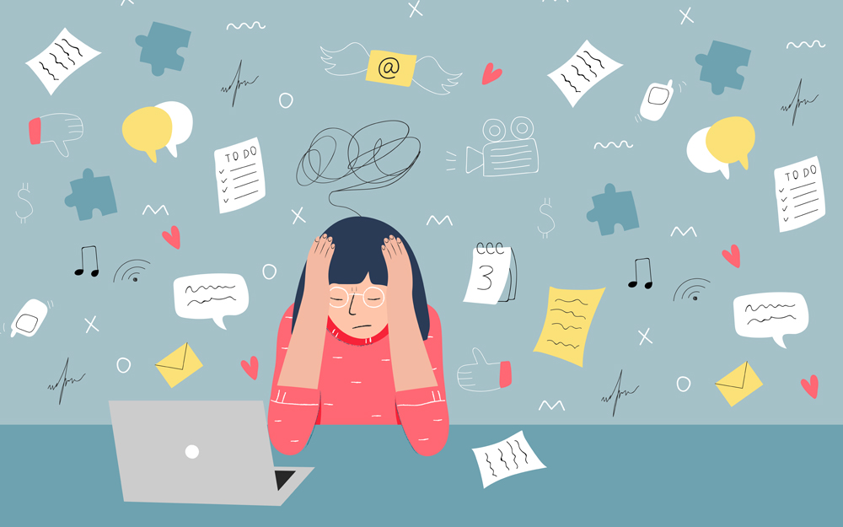
Mirro modules
Do you want to know more about topics anxiety and stress relief?
In this challenge you can choose a minimum of 3 Mirro modules
https://account.mirro.nl/api/surfconext/signon/buas
After completing the modules write a short (max 1 A4) reflection on your main take-aways
Contact person: Margot Neggers
Grief
Anxiety
Sadness
Relationship problems
Worrying
Alcohol
Self-image
Stress among students
In control of your smartphone
Concentration and procrastination
Sleep tight!
Studying in the Netherlands

Slide 12
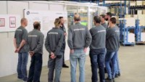
Company challenge: DKG

Slide 13

Company challenge: DKG
DKG is market leader in producing kitchen in the Netherlands (Bruynzeel keukens)
The company desires to become more data-driven and use more AI in their factory and production processes.
In groups of 4 you will be assigned a department within the company and work with one of their employees on creating a policy plan to see where AI can improve their processes.
Contact person: Margot Neggers

Slide 14

Own challenge
If you did or plan to do your own extra-curricular activity such as
(summer) school
Side project
Hackathon
Self-study topic
This might also be eligible as a challenge
However: discuss this with your mentor!
Contact person: mentor or content expert

Slide 15
Preference
Use this link to convey your preferences on a challenge:
https://forms.office.com/e/fQEuwN9339
The deadline is Friday 22th of December!
Division is communicated in week 6, in the week after Christmas holiday

